Slide 1
Multi-domain Command & Control
CMSgt Brian Stafford
Superintendent, MDC2 ECCT
23 Aug 17

Slide 2
As a reminder…
CSAF’s 3rd “Big Rock”
Multi-domain C2 is key to success in future war
Connective tissue of joint fight
Complex and will require a broad effort
Enterprise Capability Collaboration Team to address cross-functional high priority mission areas
Purpose
Provide an assessment of the Air Force’s Multi-Domain C2 Core Mission
Offer investment options (materiel & non-materiel) to enhance our capabilities
Enhancing old processes/capabilities insufficient
Set conditions for leap in capabilities

Slide 3
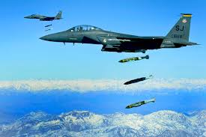
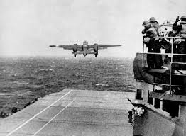
Challenge
Competitors have invested heavily in A2AD (IADS, ASATs, CNA) and threaten our current military advantages in the air, space and cyber domains
To preserve our advantage in the future, we must advance our concept of multi-domain operations
Integrated
Domains
Very
Complex
Advanced
Dilemma
For
Adversary
Synergistic Effects
Coordinated
Domains
C2
Capability
Synchronized Effects
Additive
Domains
Enhanced Effects
Tough
Expanded
Ability to integrate domains to create multiple, complex dilemmas for an adversary,
is dependent on our ability to design and implement an advanced MDC2 construct
Notes:
Why is Multi-domain C2 one of the CSAF’s focus areas? Because as we look forward toward future conflict, we face a significant challenge.
Our potential adversaries have invested heavily in technology designed to deny us the advantages we have enjoyed in air and space.
The Anti-access, Area Denial weapons in air defense, ballistic missiles, anti-satellite weapons and computer network attach threaten our ability to generate effects in the manner we have in the past and currently.
To preserve our military advantages, we must advance our concept of multi-domain operations.
In the past, we have leveraged assets in multiple domains to solve tough problems. In 1942, the Navy could not get close enough to Japan to target them and AAF aircraft could not transit the Pacific ocean-distances to hold Japanese targets at risk. But through innovation and daring, a multi-domain solution in the form of the Doolittle Raid enabled combat effects on the Japanese homeland.
Today we continue to use assets operating in multiple domains to increase our combat effectiveness. However, for the most part our space and cyber capabilities are used to enhance our air capabilities. This is natural as we have not generally had to contest the space and cyber domains and it was the best use of our resources. In the future, we will have to fight for space and cyber superiority and we will not be able to operate in the air with the degree of freedom we currently enjoy. To remain effective, we must leverage effects from all domains in a synergistic way

Slide 4
Attributes of critical C2 functions
Situational Awareness
Access all relevant data
Discern decision-quality information in operationally-relevant context
Rapidly observe and orient to dynamic intel
Determine blue force availability in real-time
Leverage relevant open source info
Operational Decision-Making
Rapidly account for constraints and restraints
Delegate to the lowest operationally-competent level
Make decisions in support of the desired ops tempo
Understand impacts across operational seams
Plan effectively for force packages
Ensure Unity of Effort for force packages
Operational
Decision-Making
Shared
Data Structure
Situational
Awareness
Force
Direction
Battle Management
Identify, assess and address changes to threat environment in real-time
Dynamically adjust missions to changes in force packages
Effectively make Go/No-Go decisions
Execute CC Intent in absence of direction/communication
Communicate securely with tactical force packages
Force Direction
Provide clear guidance to force packages
Communicate securely to all elements of force packages
Effectively direct attached forces
Dynamically clarify ROE
Effectively assess operational risk to forces
Dynamically allocate and reallocate missions
Battle Management

Slide 5
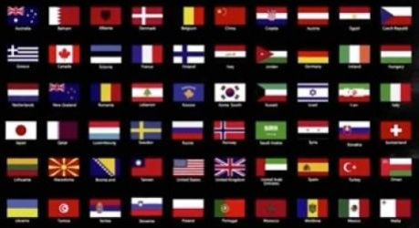
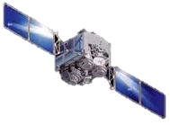
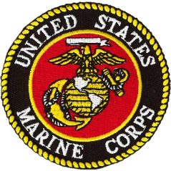
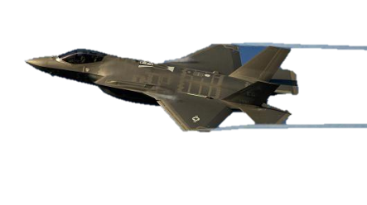
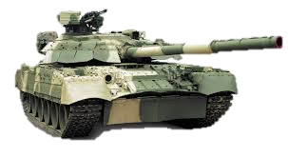
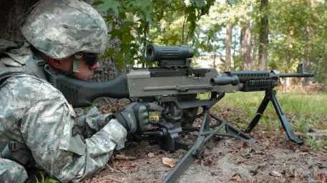
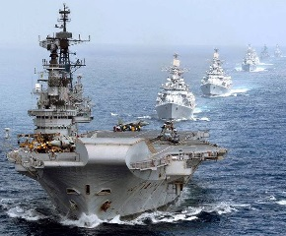
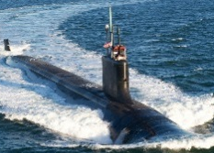
Future Warfare
Cyber
Space
Air
Land
Maritime
Sub-surface
Notes:
“Projected AF force structure is not capable of fighting and winning against this array of potential adversary capabilities”
AF must develop “multi-domain capabilities and capacity”
Future War: Multi-regional, Multi-domain, Joint, Coalition and High Velocity Ops Tempo
4 of these features create seams that must be managed…and the high velocity feature will require us to have the operational agility to navigate these seams expertly and thereby mitigate any operational impact they may otherwise cause

Slide 6
Vision for Multi-Domain Operations
MDO leverages seamless, dynamic and continuous integration of capabilities generating effects in all domains.
Advanced multi-domain operations are high velocity, operationally agile operations that present multiple dilemmas for an adversary at an operational tempo they cannot match.
As envisioned, the Multi-domain Operations end state is achieved when:
Coalition forces have the operational agility to seamlessly shift between levels of war, geographic areas, missions, functions and warfighting domains.
Coalition forces can dynamically create multiple dilemmas for an adversary at an operations tempo they cannot match.
Coalition forces have the support processes and resiliency to conduct sustainable, persistent operations in spite of a contested battlespace.

Slide 7
What does this mean for operations?
Future wars will be decided by the side with an information advantage
I&W, resolving “gray zone” with attribution, intent determination, COG transparency
Therefore, we must wield information like firepower with C2 software as weapons
We must be postured to respond to relevant information with high velocity decision-making
Machine-to-machine decision-making where appropriate
Systems which “tee up” and prime decision-makers to act on response options
We must be able to create complex, simultaneous dilemmas for adversary
Attack vectors must come from all domains to complicate defense
Response resiliency derived from effects disaggregation across domains
Synchronized, integrated and massed effects
We must have self-healing systems with perpetually optimized operations
Shortfalls and vulnerabilities immediately addressed to create continuous pressure on adversary

Slide 8
Overarching Plan of Attack
In order to keep multi-domain command and control perpetually optimized to provide high velocity, operationally agile operations, the Air Force will:
Build and formally develop an operational-level C2 Cadre
Provide them the tools, data and IT infrastructure on the leading edge of technology
Exploit purpose-built opportunities to explore enhanced C2 processes and concepts
C2
Concepts
Leading Edge
Technology
Key is to build processes, procedures, forums and mechanisms to allow continual development of experts, tools and concepts.
Success is about processes not products
Professionally developed MDC2 Cadre

Slide 9
Enlisted Force
Institutional Competencies
EPME, Professional Development
Leverage talent management
Be creative! Embrace cultural change! Think “Yes, if…”

Slide 10
QUESTIONS?

