Slide 1
Multi-domain Command & Control
Brig Gen Chance “Salty” Saltzman
Director of Current Operations
24 Aug 17

Slide 2
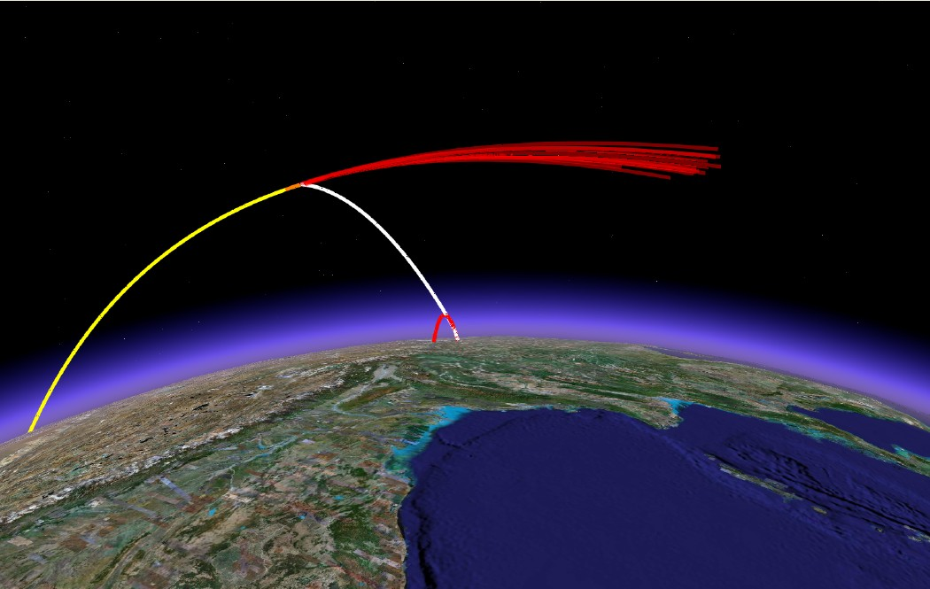
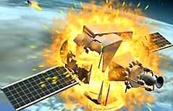
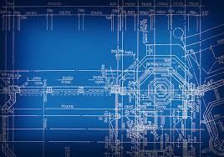
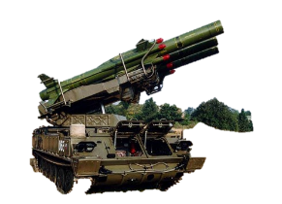
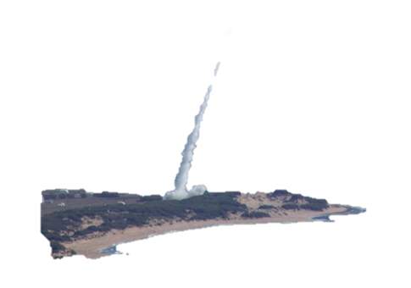
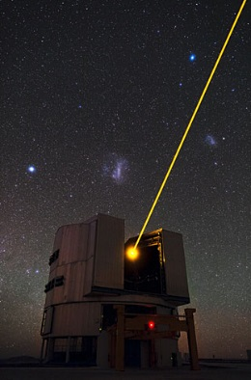
AS 2030 states “the AF’s projected force structure is not capable of fighting and winning against this threat array without a shift in focus to multi-domain capabilities and capacity”
Ground Based Lasers
Light speed Crippling Effects
Co-orbital ASATs
Attack on Demand
Direct Ascent ASAT
~8 min Time of Flight
Computer Network Attack
ICBMs
IADS
Mobile SAMs
Standoff Weapons (~1400km range)
Notes:
Primary Reason for Change is the Security Environment that we expect in 2030 and beyond
Security Environment of 2030 will have “Increased threats to negate our advantages in space domain, increased quantity and sophistication of cyber threats and air threats including hypersonic weapons, low observable cruise missiles and sophisticated conventional ballistic missile systems

Slide 3
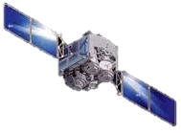
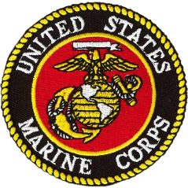
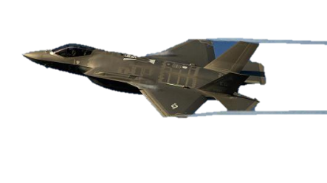
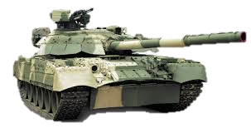
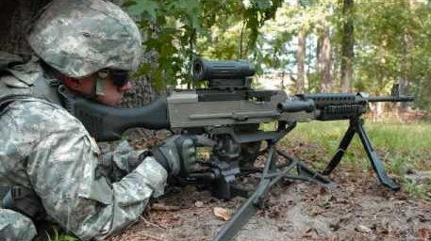
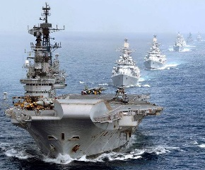
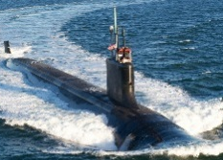
Future Warfare
Cyber
Space
Air
Land
Maritime
Sub-surface
Notes:
“Projected AF force structure is not capable of fighting and winning against this array of potential adversary capabilities”
AF must develop “multi-domain capabilities and capacity”
Future War: Multi-regional, Multi-domain, Joint, Coalition and High Velocity Ops Tempo
4 of these features create seams that must be managed…and the high velocity feature will require us to have the operational agility to navigate these seams expertly and thereby mitigate any operational impact they may otherwise cause

Slide 4
What does this mean for operations?
Future wars will be decided by the side with an information advantage
We must be postured to respond to relevant information with high velocity decision-making
We must be able to create complex, simultaneous dilemmas for adversary
We must have self-healing systems with perpetually optimized operations
Notes:
Future wars will be decided by the side with an information advantage
I&W, resolving “gray zone” with attribution, intent determination, COG transparency
Therefore, we must wield information like firepower with C2 software as weapons
We must be postured to respond to relevant information with high velocity decision-making
Machine-to-machine decision-making where appropriate
Systems which “tee up” and prime decision-makers to act on response options
We must be able to create complex, simultaneous dilemmas for adversary
Attack vectors must come from all domains to complicate defense
Response resiliency derived from effects disaggregation across domains
Synchronized, integrated and massed effects
We must have self-healing systems with perpetually optimized operations
Shortfalls and vulnerabilities immediately addressed to create continuous pressure on adversary

Slide 5
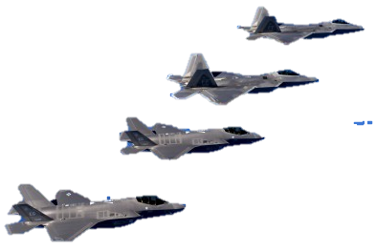
Vision of MDO…2030 Vignette
Suppression of Enemy Air Defenses in a regional conflict
Air Force capability to conduct the mission will include air, space and cyber platforms
Force package built from on-orbit, virtual and airborne capabilities
Multiple attack vectors to drive missiles autonomous and degrade target acquisition
Supported/Supporting arrangements?
Multi-domain Package Commander?
Multi-domain Tasking Cycles?
Multi-domain Battle Management?
Cmd relationships of multi-domain forces?
Multiple Ops Floors Sync’d?
Space Superiority as prerequisite
Multi-node Collaborative Planning

Slide 6
Attributes of critical C2 functions
Situational Awareness
Access all relevant data
Discern decision-quality information in operationally-relevant context
Rapidly observe and orient to dynamic intel
Determine blue force availability in real-time
Leverage relevant open source info
Operational Decision-Making
Rapidly account for constraints and restraints
Delegate to the lowest operationally-competent level
Make decisions in support of the desired ops tempo
Understand impacts across operational seams
Plan effectively for force packages
Ensure Unity of Effort for force packages
Operational
Decision-Making
Shared
Data Structure
Force
Direction
Situational
Awareness
Battle Management
Identify, assess and address changes to threat environment in real-time
Dynamically adjust missions to changes in force packages
Effectively make Go/No-Go decisions
Execute CC Intent in absence of direction/communication
Communicate securely with tactical force packages
Force Direction
Provide clear guidance to force packages
Communicate securely to all elements of force packages
Effectively direct attached forces
Dynamically clarify ROE
Effectively assess operational risk to forces
Dynamically allocate and reallocate missions
Battle Management

Slide 7
Operational Approach
In order to keep multi-domain command and control perpetually optimized to provide high velocity, operationally agile operations, the Air Force will:
Build and formally develop an operational-level C2 Cadre
Provide them the tools, data and IT infrastructure on the leading edge of technology
Exploit purpose-built opportunities to explore enhanced C2 processes and concepts
C2
Concepts
Leading Edge
Technology
Key is to build processes, procedures, forums and mechanisms to allow continual development of experts, tools and concepts.
Success is about processes not products
Professionally developed MDC2 Cadre

Slide 8
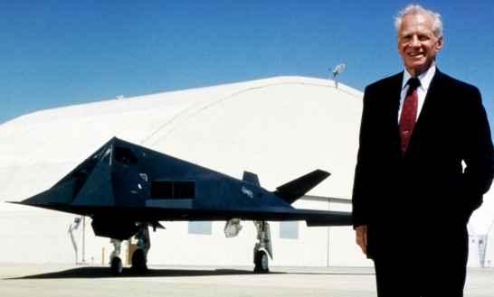

Slide 11
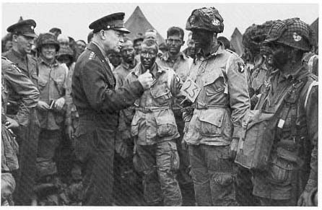

Slide 13
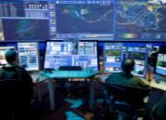
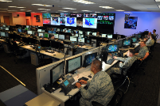
Adding CACTECH Model to WEPTAC
SPO/ Labs
Support
Tech & Data
Challenges
Tech Ops
Review
Council
CURRENT
OPERATIONS
Experiments
Tech Demos
READY
FORCES
Operational
Test & Eval
Tech
Summit
TECH
OPS
ShadowOC
Test
Agile Acquisition
Min Viable Prod
WEPTAC
Conferences
Document
Tactics
Procedures
Innovate
Develop
Threat
Assessment
Commercial
Tech Industry
Tactics
Review
Board
Improved
Mission Apps
Data Analytics
C2 Systems
WEP
TAC
Realistic Training
Review Board
Tech Ops
Improvement
Process
Tactics
C2 Ops
Challenges
CACOPS
Review
Council
Train
Validate
Training
Ready Aircrew
Program
& Flags
Tactics
Improvement
Process
Enhanced
C2 TPPs
Resource
Operational
Training Infrastructure
C2
Summit
Advanced Tech Cycle
Leverage Innovation from all sources
Utilize DevOps Environment
User-centered Design
Test Driven Development
Minimum Viable Products
Document
AFOTTP
Vol 2-1
CAC
OPS
Lessons
Learned
CACOPS
Improvement
Process
Ops Enhancement Cycle
Perpetual C2 Ops Improvement thru C2 OPS Model
Perpetual Force Readiness thru WEPTAC Model
Advanced Tech Cycle
Innovate
Train
Experimentation
Wargames
Blue Flag
MDO Exercises
505th Courses
C2 Training
Review Council

Slide 14
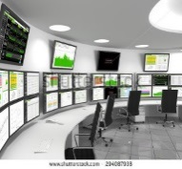
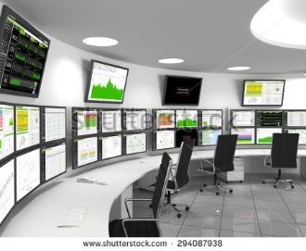
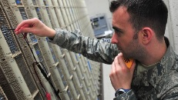
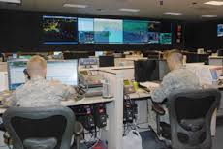
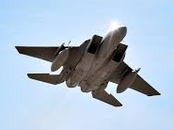
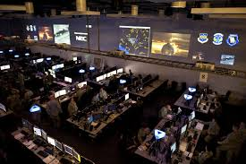
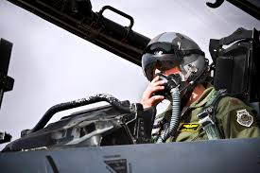
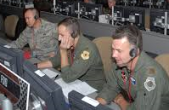
CACTECH Operating Concept
609th
AOC
607th
AOC
AFWorks
(Innovation Gateway)
SPOs
(Hardware)
New S&T
(AFRL, DARPA)
Commercial Tech
(IRAD, Non-Traditionals)
613th
AOC
624th Cyber
CURRENT
OPERATIONS
MDC2 DevOps Environment
Developers & Operators
614th
AOC
603rd
AOC
Rapid Tech Development
Design to Test methods
Supercomputer AI, Analytics
Visualization, Gaming Interfaces
Distributed Planning Tools
Software Factory
+
Virtualized Data
(Storage/Processing)
CMCC
C2 Systems
Data sharing on a common platform between all OC’s
OA-DCGS
C2 Cadre
IQT & FTUs
C2WAC
C2 WEPTAC (OTTPs)
AI WIC
Mission Needs
Perpetually
Enhanced
MDC2
NSDC
Info Sharing
Security
Environment
Validated C2 Tech & TTPs
TACC
CACOPS
Training, Education, TTP Dev
Test & Validation
Live-fly, Test, Exp
53rd Wing
57th Wing
USAFWC/Flags
Functions not locations
Multi-node concept
Net-enabled, Web delivered

Slide 15
DevOps Guiding Principles
Ensure real-world data (virtualized) is available to DevOps
Architect the infrastructure to rapidly integrate all relevant data sets (virtualize the data)
Develop/utilize Air Force software coders/designers/engineers
Eliminate stovepiped proprietary systems, leverage COTS with gov’t mods
Ensure trained C2 Cadre are “side-by-side” teaming with software developers
DevOps environment enables direct, on-site collaboration
Leverage Open Architecture and Code
Publish IT, data, interface and messaging standards for easy integration of new capability
Employ “AppStore” model for mission application delivery
Establish/Maintain low entry threshold for commercial software innovation
Broad base of app developers due to published IT standards and integration reqmnts
Utilize ‘Design To Test’ methods employed for rapid fielding
When coding is complete, so is testing (field ready)
Ensure DevOps products are extensible/scalable to C2 Enterprise
Web-based applications to facilitate frequent over-the-air upgrades to all users
Deliver Minimal Viable Products to C2 operators at speed of need
NO delivery to requirements, quick useable product to be “fixed” with field feedback
Employ commercial best practices for Info Assurance

Slide 16
Technology Goals and Objectives
Leverage agile acquisition to field C2 systems in support of Multi-domain ops
Provide C2 force with relevant, leading edge mission applications iso C2 functions
Field enterprise-wide modern C2 infrastructure (hardware, enterprise services, etc)
Virtualize and secure data needed to accomplish MDC2
Deliver assured comm networks to enable C2 in contested environments
Ensure networks are resilient across regions
Ensure networks are connected globally
Ensure C2 connectivity extends to the tactical edge and integrates all assets
Leverage advanced technology (AI, ML, etc) to enhance and accelerate C2 functions
Automate functions to enhance human performance in C2 nodes
Leverage technology to rapidly go from data to decision
Leverage technology to accelerate and improve decision-making

Slide 17
Final Thoughts
We are just getting started…you have not been left behind
Senior leadership is committed to new AQ processes for C2 systems
Help us find our way…
An Air Force culture shift is underway…traditional industry relationships must evolve
Large C2 PoRs with aggregated requirements are out…
Proprietary data, algorithms and stovepiped systems are out…
Make sure you understand our vision…let us help you
Help us understand where you can contribute to the vision

